Slide 1

Secure an Editor
Yaakov Cohen

Slide 2
Introduction
The project aims is to create a simple at possible product to the user,
That add to existing text editor,
file encryption capabilities without the intervention of the user.

Slide 3
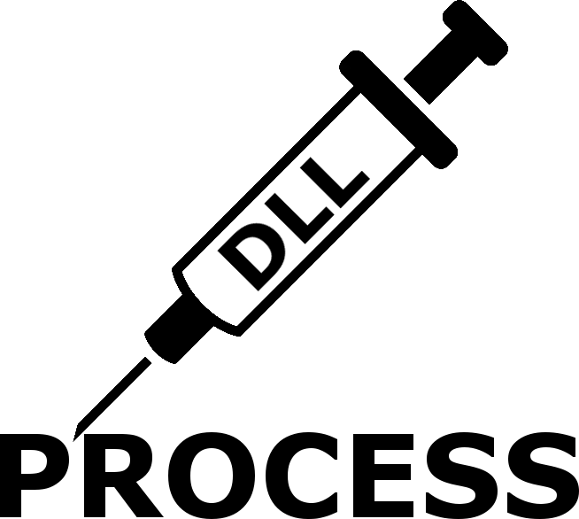
DLL INJECTION

Slide 4

DLL INJECTION
We will discuss about two methods:
  AppInit_DLLs registry key.
  CreateRemoteThread.

Slide 5
AppInit_DLLs registry key
Legitimate way to do DLL Injection.
Documented by Microsoft.
Will inject the DLL to all processes that load user32.dll (almost all processes in Windows).
Must be done by Admin user.
"Today, only a small set of legitimate applications use this mechanism. Unfortunately, a larger set of malware use this mechanism. Applications and malicious software both use AppInit DLLs for the same basic reason, which is to hook APIs”
Microsoft.

Slide 6
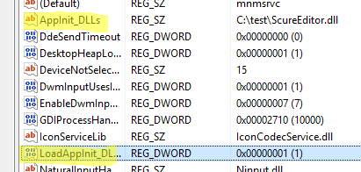
AppInit_DLLs registry key
Add the DLL path to the registry key.
The key path is different for x86 or x64 Windows OS and by the DLL build architecture.

Slide 7
CreateRemoteThread
Not need Admin Privileges.
The user can decide to use it or not.
Inject the dll by WINAPI function.
This method works only when the process is already running.

Slide 8
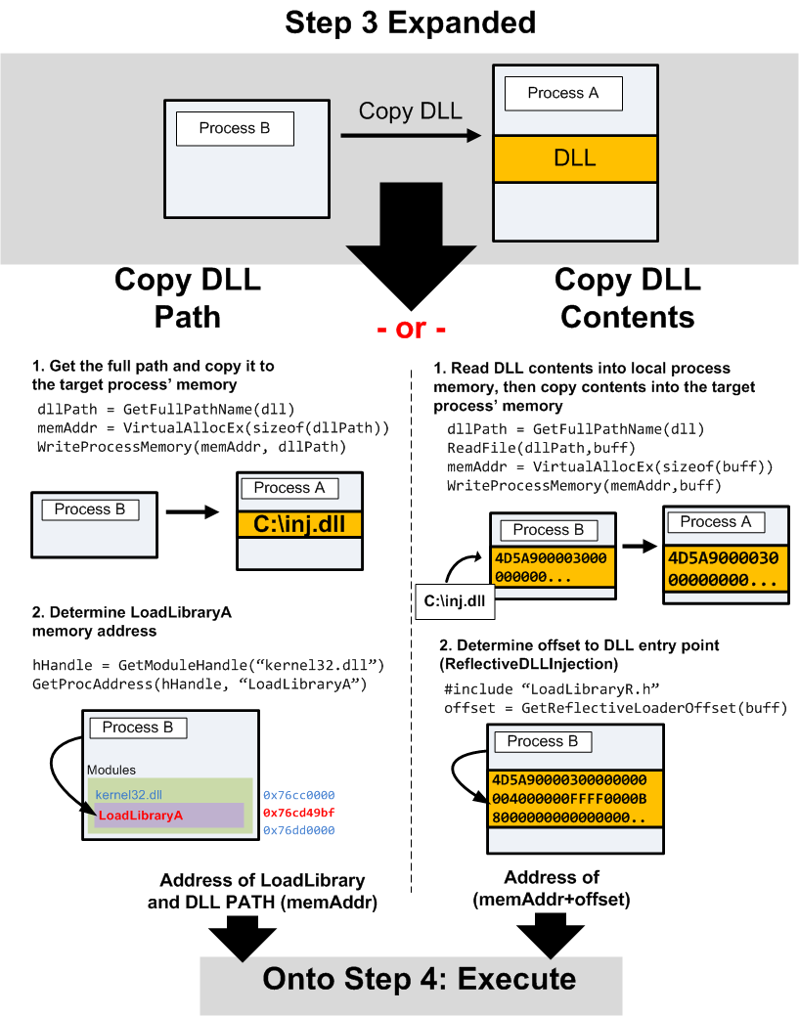
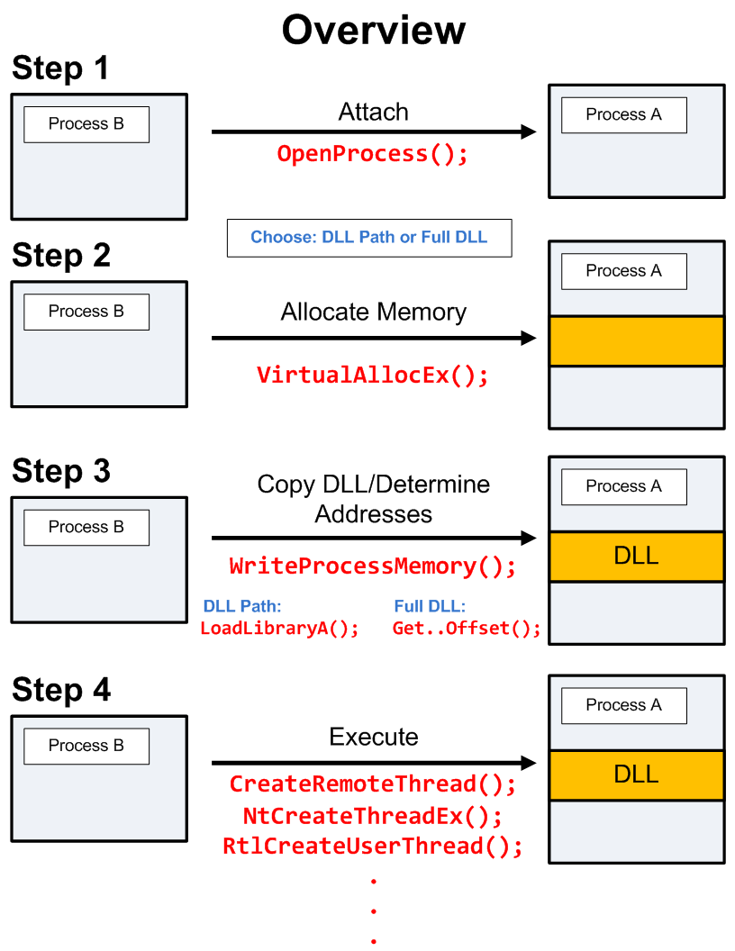
CreateRemoteThread

Slide 9

API HOOKING

Slide 10
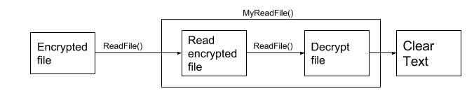
API HOOKING
Alter or augment the behavior of software components by intercepting function calls.
We want to hook all the read and write calls.
For example WINAPI Read File function:

Slide 11
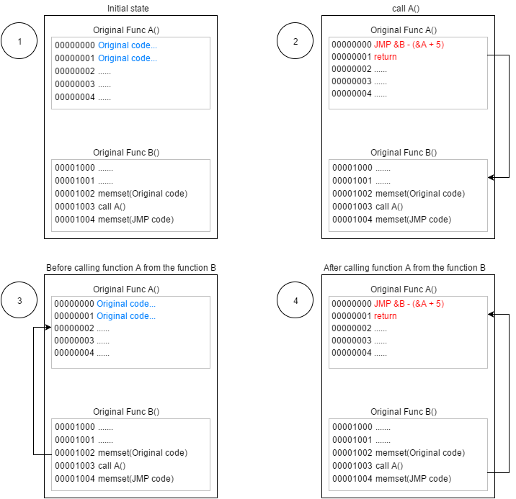
API Hooking Using JMP Instruction
Because of the calling convention if we don’t change the stack we can get all the function args just by declaring the same function prototype.

Slide 12
API Hooking Using JMP Instruction
JMP Instruction on Multithreading process:
  Race condition.
  Critical section.
Helpful C++ tools:
  Mutex.
  Recursive mutex.
  Lockguard.

Slide 13
Encryption Mechanism
Requirements :
User friendly.
Create unique key for each file (Security in depth).
Can be opened by authorized third-party (Transfer files, Backup, IT Department).

Slide 14

Key Hierarchy

Slide 15
Key Hierarchy
A-symmetric Key for each user (Public and Private).
Symmetric Key for each file.
Encrypt the file by the Symmetric Key.
Encrypt the Symmetric Key by the user’s Public Key.
The Private key will be encrypted by symmetric algorithm with the user’s password as key.

Slide 16
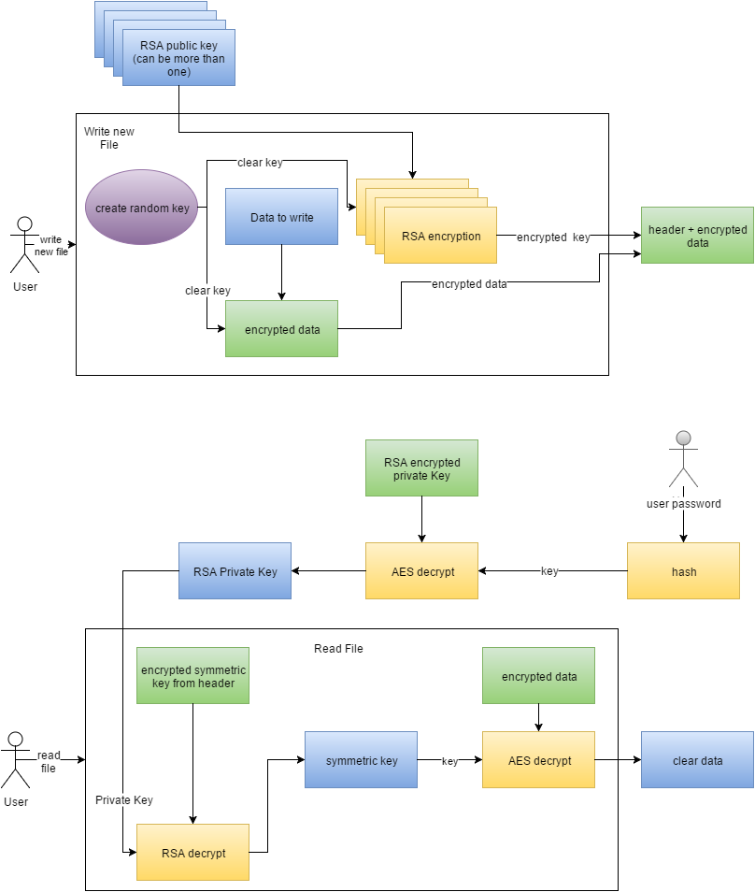
Key Hierarchy
Write File

Slide 17
Key Hierarchy
Read File

Slide 18
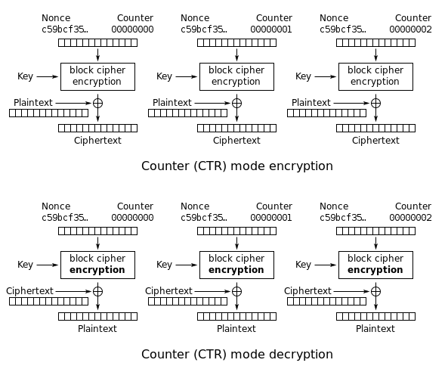
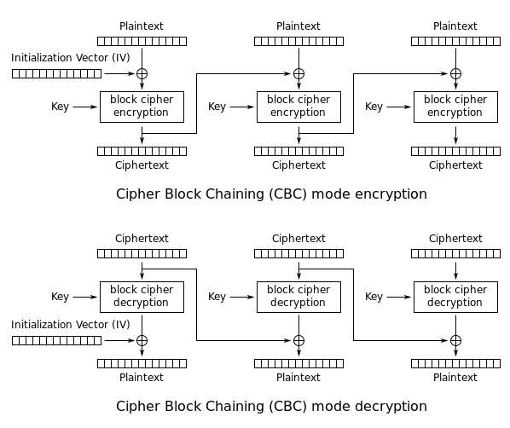
Why not CBC mode?
We read only one block at the time, not the all file.

Slide 19
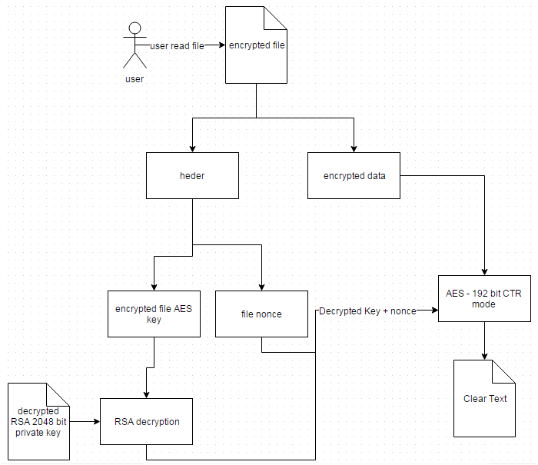
Read File

Slide 20
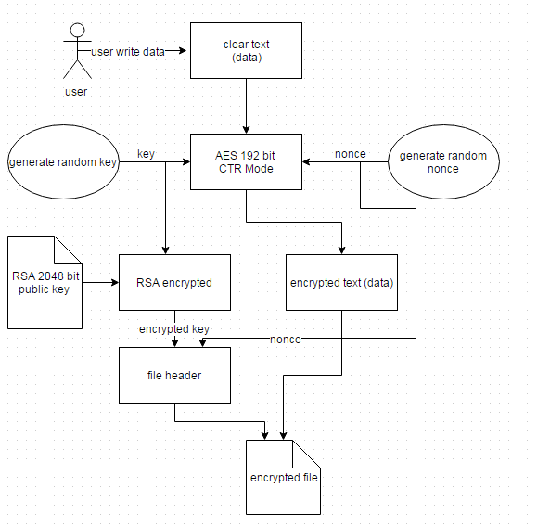
Write New File

Slide 21
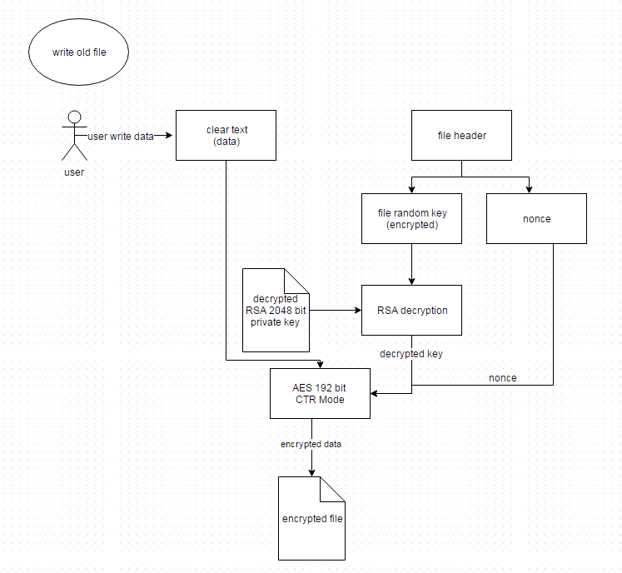
Edit File

Slide 22
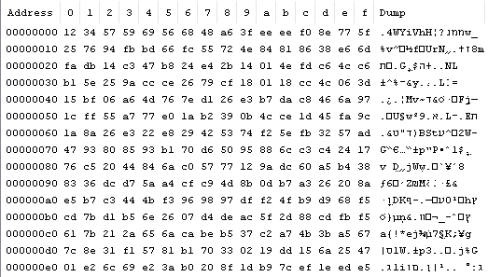
Encrypted File Structure
Header.
  Magic.
  Encrypted Symmetric Key(s).
  Nonce.
Encrypted Data

Slide 23
דוקטור,
אני רק שאלה
?

